Slide 1

Response to TeleComX AI‑Driven Customer Support Chatbot
May 2025

Slide 2
Agenda
Client & Market Overview
Project Goals & ROI
Scope of Work
Technical Approach
Data Privacy & Security
Timeline & Next Steps

Slide 3
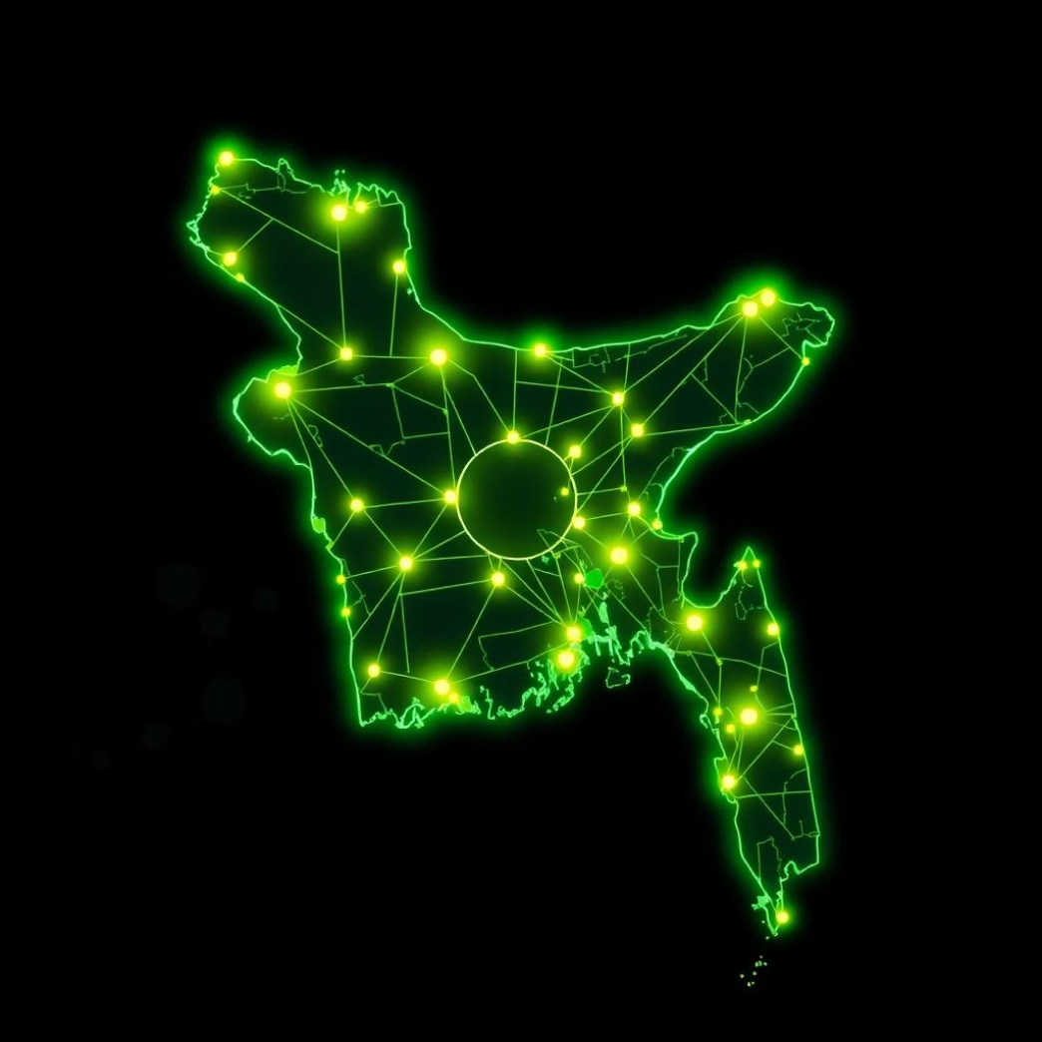
Client & Market Overview
TeleComX: Bangladesh Leader
Market Demand
Fast-growing need for self-service & 24/7 support.
Serves 10+ million customers nationwide.
Opportunity to reduce costs & boost satisfaction.
Leading telecom provider, committed to innovation.

Slide 4

Project Goals & ROI
80%
2
50%
Automate Queries
Bilingual Support
Reduce Response Time
Common customer inquiries.
English & Bengali.
Average customer query time.
Seamless Salesforce CRM & Zendesk integration.
Improve CSAT & lower agent workload.

Slide 5
Scope of Work
Define Requirements
Finalize use cases & conversation flows.
Develop Chatbot
NLU-powered for web & mobile.
Integrate Systems
Salesforce CRM & Zendesk APIs.
Admin Dashboard
Monitoring, analytics, conversation management.
Deploy & Support
Testing, training, 6-month post-launch support.

Slide 6

Technical Approach
Cloud-native, microservices architecture for 99.9% uptime.
RESTful APIs with OAuth2, JSON, HTTPS, rate-limit handling.
React widget for web; Flutter SDK for mobile apps.
Context management for seamless live agent escalation.
Multimedia support: text, images, links.

Slide 7





Data Privacy & Security
Compliance
Data Residency
Encryption
GDPR & Bangladesh Data Protection Act.
In Bangladesh; no cross-border transfer without consent.
TLS 1.2+ in transit; AES-256 at rest.
Access Control
Breach Reporting
Role-based access & full audit logging.
24-hour reporting & mandatory staff training.

Slide 8

Timeline & Key Milestones

Slide 9

Next Steps & Contacts
Next Steps
Key Contacts
Review proposal & finalize contract.
Imran Hossain (Project Owner)
Schedule detailed scoping workshops.
Farhana Rahman (Executive Sponsor)
Assign TeleComX & vendor project teams.
Sazzad Mahmud (Procurement Backup)

